Slide 1
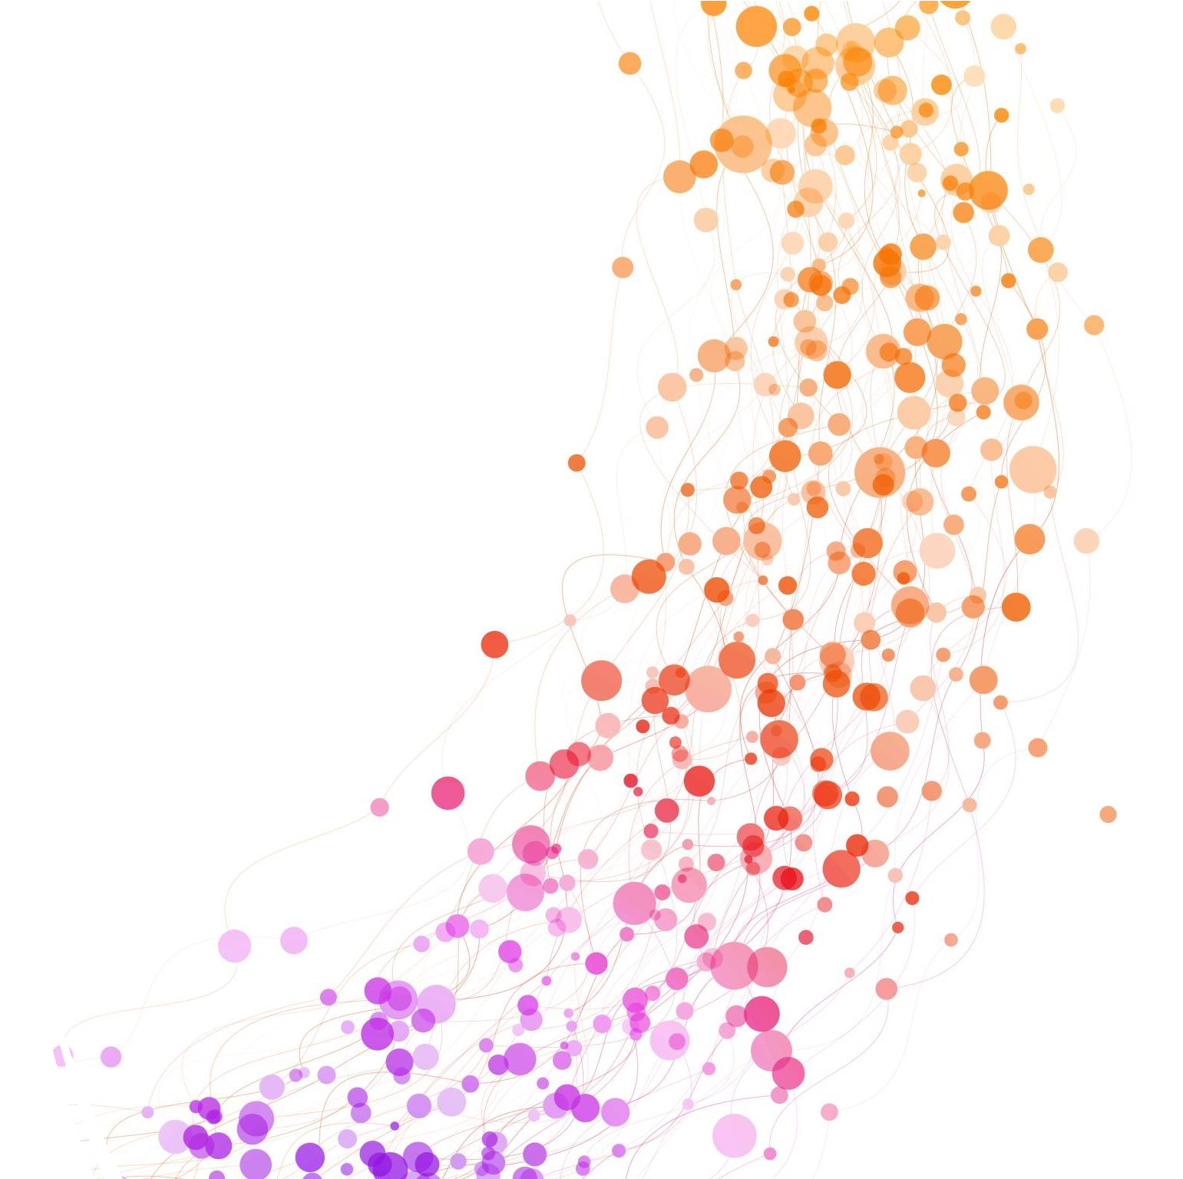
Introduction to Machine Learning
By Jeewaka Perera

Slide 2
Lesson Objectives
At the end of the lesson students should be able to explain
What is Machine Learning?
Why Choose Machine Learning?
Different Machine Learning Algorithms and their applications

Slide 3
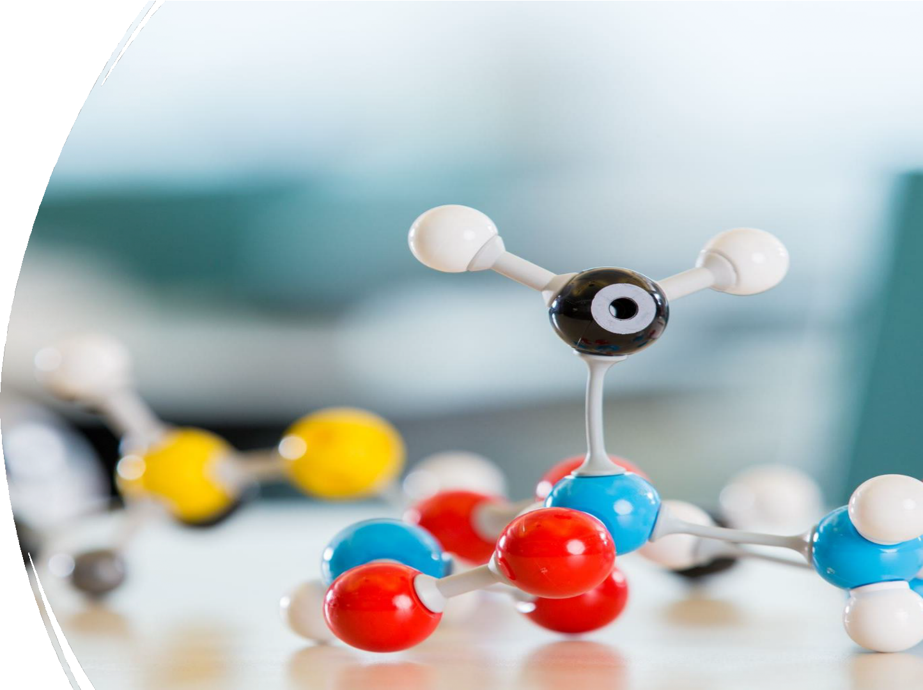
What is Optimization?
Optimization is the mathematical discipline which is concerned with finding the maxima and minima of functions, possibly subject to constraints.

Slide 4
What is Artificial Intelligence
" It is the science and engineering of making intelligent machines, especially intelligent computer programs. It is related to the similar task of using computers to understand human intelligence, but AI does not have to confine itself to methods that are biologically observable.“ by John McCarthy

Slide 5

What is Machine Learning
“field of study that gives computers the ability to learn without explicitly being programmed.” by Arthur Samuel
Machine learning is a subfield of artificial intelligence, which is broadly defined as the capability of a machine to imitate intelligent human behavior.

Slide 6
Learning in a Machine
“A computer program is said to learn from experience (E) with some class of tasks (T) and a performance measure (P) if its performance at tasks in T as
measured by P improves with E”

Slide 7
ML vs Traditional programming
Traditional Programming
Data Program
Computer
Output
Machine Learning
Learning Algorithm
Data
Computer
Program
Output

Slide 8

Types of Artificial Intelligence Algorithms
Rule-based expert Systems
Search Algorithms
Evolutionary Algorithms and Swam
Intelligence Algorithms
Machine Learning Algorithms

Slide 9
Expert Systems
PROSPECTOR
MYCIN
Rule Based Systems
Based on pre-defined Rules
Rules defined based on domain knowledge
Designed to mimic the decision-making process of human experts

Slide 10

Search Algorithms
Breadth-First Search
Depth First Search
Iterative Deepening Search
Uniform Cost Search
Dijkstra's algorithm
A* Search
Sample Footer Text

Slide 11

Evolutionary Algorithms
Evolutionary Algorithms are a family of nature-inspired optimization algorithms that mimic biological evolution—natural selection, mutation, recombination, and survival of the fittest.
Genetic Algorithms
Particle Swarm Optimization
Cultural Algorithms
HCA KCA
SI Algorithms(ACO, FA)
Sample Footer Text

Slide 12
Steps in a generic Evolutionary Algorithm
Initialize a population of potential solutions randomly.
Evaluate each solution using a fitness function.
Select the best individuals.
Recombine (crossover) and mutate them to create new individuals.
Repeat until a stopping condition is met.

Slide 13
Applications of EA
Scheduling airline crews
Tuning hyperparameters in ML
Designing antennas (NASA example!)
Portfolio optimization

Slide 14
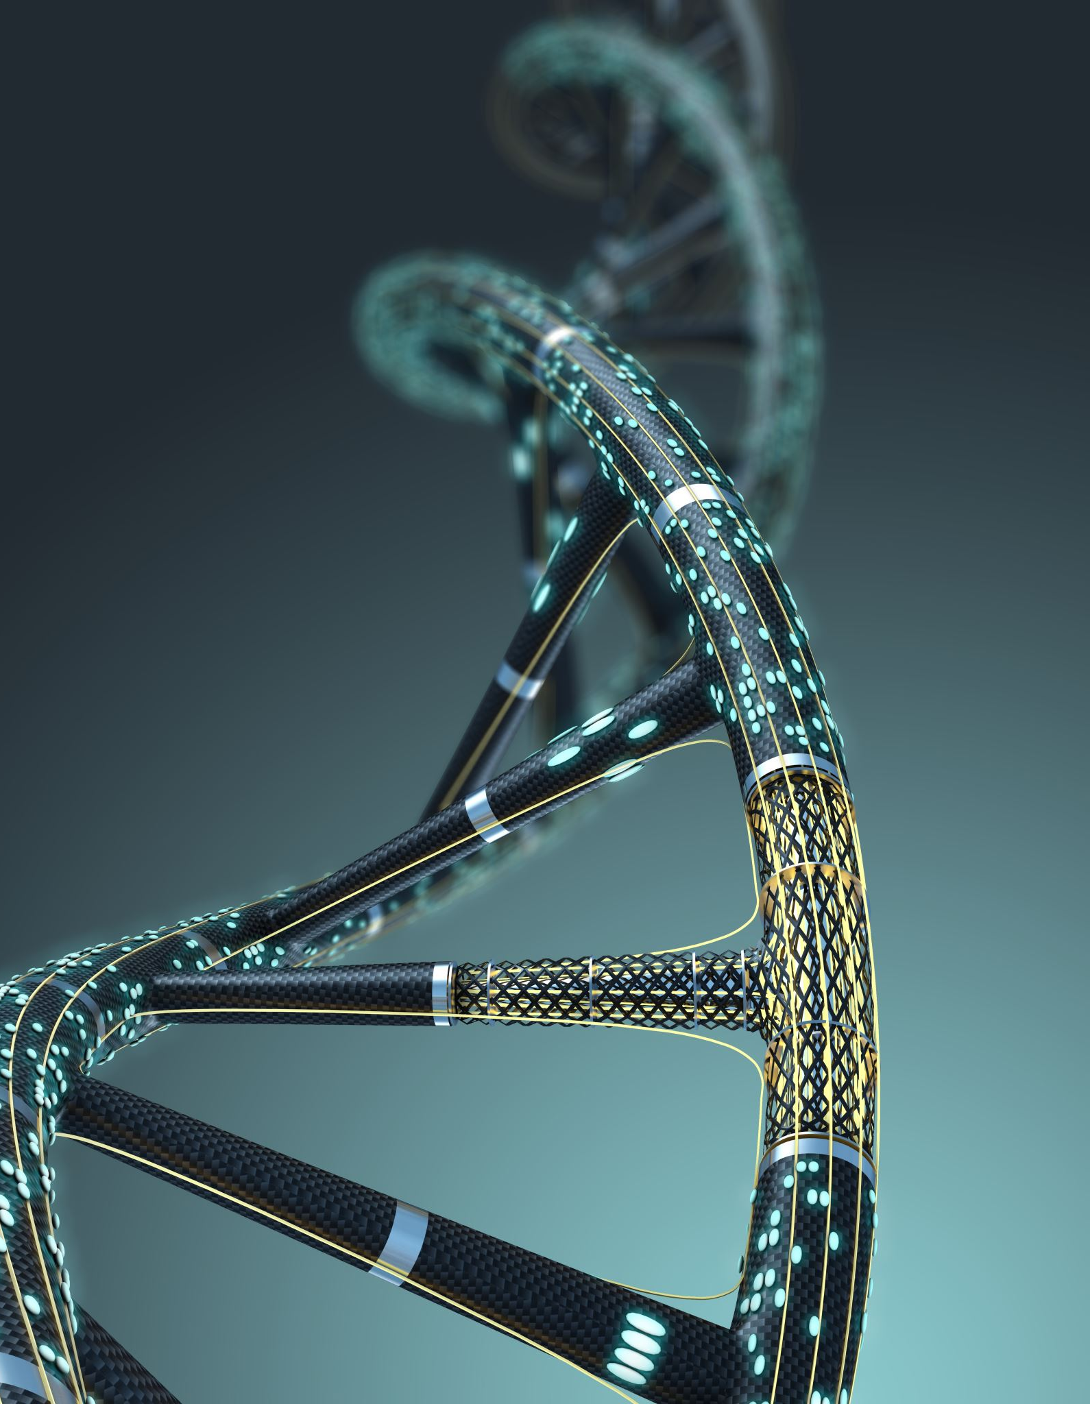
Genetic Algorithms
A Genetic Algorithm (GA) is a search and optimization method inspired by how living things evolve over time through natural selection.
We represent potential solutions as chromosomes.
Better solutions (those with higher fitness) are selected
New solutions are created through crossover and mutation
Over generations, solutions get better!

Slide 15
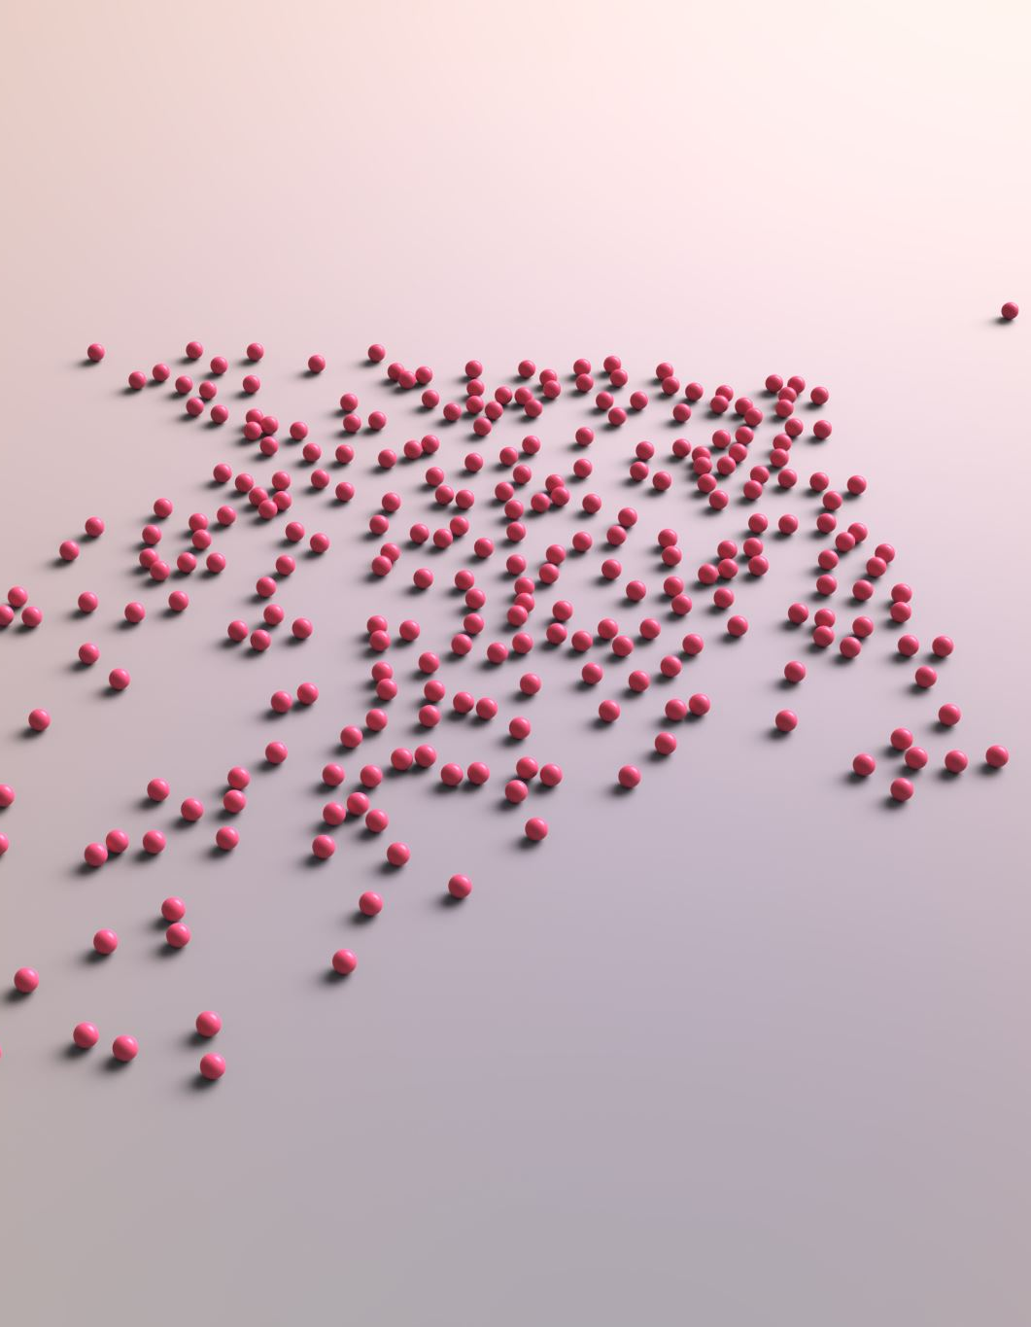
Swarm Intelligence Algorithms
Inspired by: Collective behavior of decentralized, self-organized systems (e.g., birds, ants, fish)
Ant Colony Optimization (ACO)
Inspired by ants finding shortest paths using pheromone trails.
Good for discrete path-based problems like the Traveling Salesman Problem (TSP).
Firefly Algorithm (FA)
Fireflies are attracted to brighter (better) solutions.
Uses light intensity and distance for movement.

Slide 16
Types of Machine Learning Algorithms
Supervised Learning
Unsupervised Learning
Semi-Supervised Learning
Reinforcement Learning
12

Slide 17
Supervised Learning Algorithms
Learned under supervision.
Supervision of what?
Humans?
Supervised by the Labeled data
Require labeled data. (Inputs, output)
This is the most difficult part of supervised learning.
Tuesday, February 2, 20XX
Sample Footer Text
13

Slide 18
Types of Supervised Learning Models
Regression
Predicting a Linear value
Linear Regression
SVR
DT
Classification
Predicting a class/label
Logistic Regression
SVM
DT
NB
Artificial Neural Network Models such as MLP, CNN, RNNs are Considered as supervised Learning Models
14

Slide 19
Supervised learning examples
A Bank may have borrower details (age, income, gender, etc.) of the past (features)
Also it may have details of the borrowers who defaulted in the past (labels)
Based on the above, can train a classifier to learn the patterns of borrowers who are likely to default on their payments

Slide 20
Linear Regression
Model Explanation: Draws a straight line that best fits the data.
Key Concept: Learns the relationship as a linear equation:
y = mx + c.
What is learnt through training: Finds the best slope (m) and intercept (c) to minimize error.
Example Use Cases:
Predicting house prices
Salary estimation
Sales forecasting
Limitations:
Only works well when the relationship is linear
Not suitable for complex, non-linear patterns
Sensitive to outliers

Slide 21
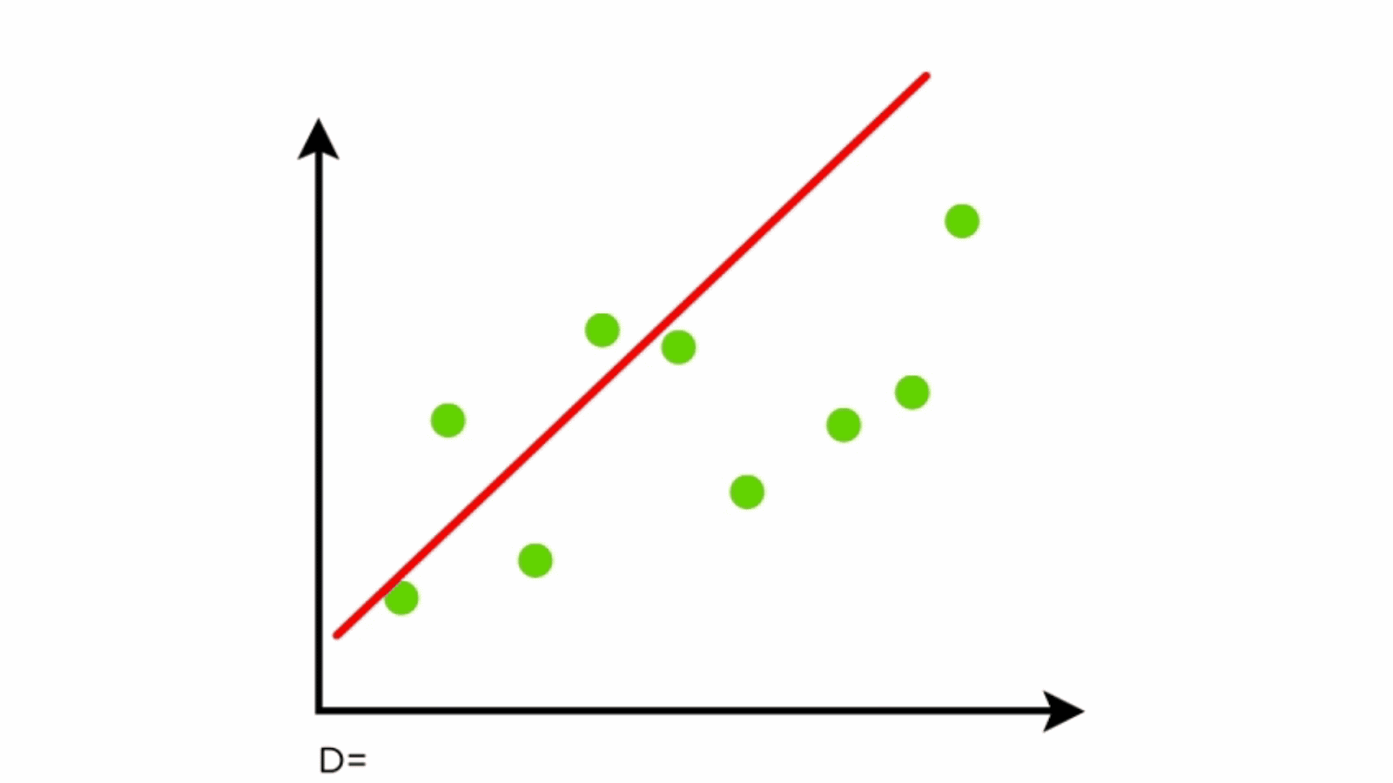
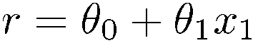
Linear regression
“Predictor”:
Evaluate line:
return r

Slide 22

Types of Unsupervised Learning Algorithms
Clustering Algorithms
K Means
DBSCAN
Dimensionality Reduction Algorithms
PCA
MDS (Multidimensional Scaling)
LDA (Linear Discriminant Analysis)
Graph Based Models can be considered as Unsupervised Learning
Sample Footer Text

Slide 23
Unsupervised learning examples
A Supermarket may store each buyer’s
basket content details (features)
There are NO grouping (labels)
Need to group the buyers based on their buying patterns in order to best use the shelf space (recommendation)

Slide 24
K- Means Clustering
Model Explanation:
Groups data into K clusters based on similarity.
Key Concept:
Finds cluster centers and assigns each point to the nearest one.
What is learnt through training:
Learns the position of cluster centers.
Example Use Cases:
Customer segmentation
Grouping articles by topic
Organizing images
Limitations:
You must choose K (number of clusters) beforehand
Assumes spherical-shaped clusters
Struggles with uneven or noisy data

Slide 25
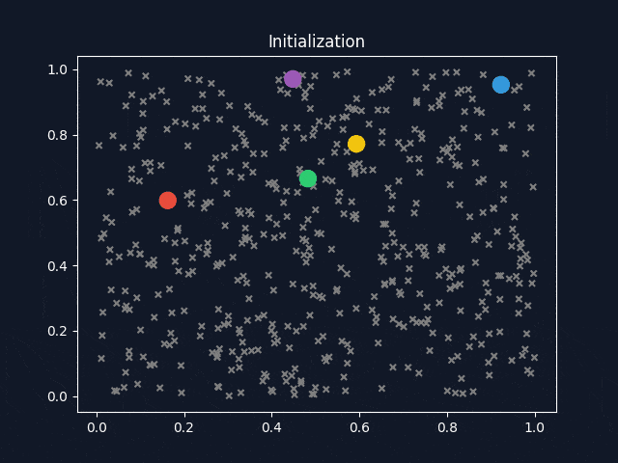
K-means clustering example

Slide 26
DBSCAN
Model Explanation:
Groups together dense areas; labels sparse points as outliers.
Key Concept:
Clusters are formed based on density, not shape or number.
What is learnt through training:
Learns which points belong to dense clusters and which are noise.
Example Use Cases:
Fraud detection
Identifying event hotspots
Anomaly detection in GPS or sensor data
Limitations:
Struggles with varying densities
Requires tuning of eps and min points
Not ideal for high-dimensional data

Slide 27
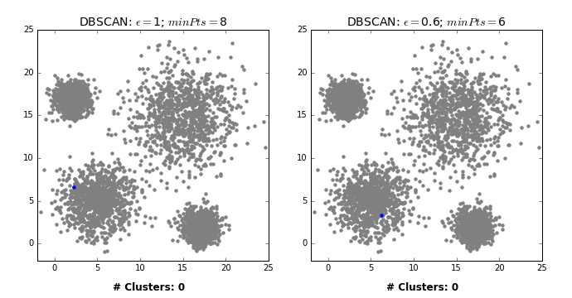


Slide 28


Slide 29
Semi-supervised learning
Labeled data is expensive/difficult to get
Unlabeled data is cheap/easier to get
The idea is to use smaller amount of labelled data with larger amount of unlabeled data to creating the training/testing datasets
Algorithms - Self Training, Generative models
Semi-Supervised Support Vector Machines, etc.

Slide 30


Semi-Supervised Learning Algorithms
Generative Adversarial Networks
Auto-encoders
Variational Auto-encoders
Sample Footer Text

Slide 31
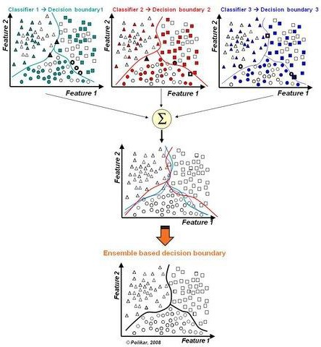

Ensemble Learning
Often, multiple classifiers need to be combined to solve a real-world problem.

Slide 32
Random Forest
Model Explanation:
Combines predictions from many decision trees.
Key Concept:
Uses voting or averaging to make decisions.
What is learnt through training:
Learns different rules from subsets of data to make robust predictions.
Example Use Cases:
Spam detection
Credit risk analysis
Disease classification
Limitations:
Can be slow with large datasets
Less interpretable than a single decision tree
Needs tuning (like number of trees)

Slide 33
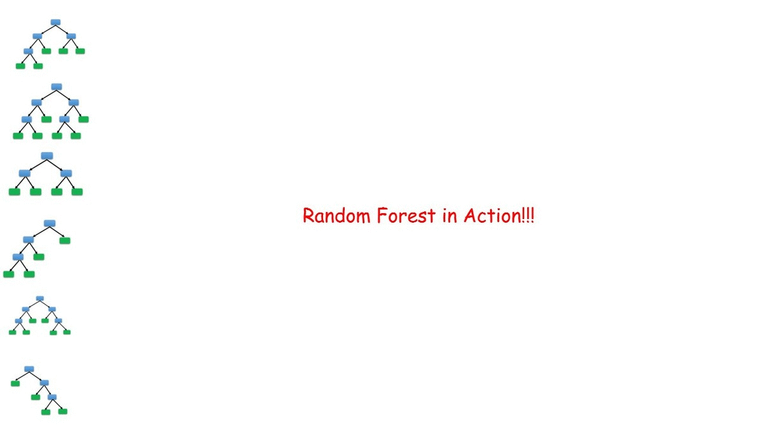


Slide 34
Reinforcement Learning
Model Explanation:
Learns by interacting with an environment and receiving feedback (rewards or penalties).
Key Concept:
Uses trial-and-error and reward maximization to improve decision-making over time.
What is learnt through training:
Learns an optimal policy or action strategy that maximizes long-term rewards.
Example Use Cases:
Game playing (e.g., AlphaGo)
Robotics (e.g., navigation or motor control)
Dynamic pricing or recommendation systems
Limitations:
Requires many interactions with the environment (sample inefficiency)
Can be unstable or hard to converge
Needs careful reward design to avoid unintended behaviors

Slide 35

Reinforcement learning examples
A group of robots have been deployed in an unknown territory
The objective is for them to collaboratively find the navigation path to reach a particular destination/goal
Can use reinforcement learning where achieving the goal/getting closer to the goal gives a positive reward. Negative reward otherwise
Can share the information among robots (multi-agent system)
24

Slide 36
Comparing Machine Learning Models
Not all models are created equal — and neither are the ways we evaluate them.
Key Questions to Ask:
Is it a classification, regression, or clustering task?
Do we care more about correctness, fairness, or interpretability?
What are the costs of wrong predictions?

Slide 37
Common Evaluation Matrices
Task Type | Metrics Used
Classification | Accuracy, Precision, Recall, F1 Score, ROC-AUC
Regression | MSE, MAE, RMSE, R² Score
Clustering | Silhouette Score, Davies-Bouldin Index, Inertia
Ranking/Recommendation | MAP, NDCG, Hit Rate

Slide 38
Classification Matrices Explained
Metric | Use When... | Notes
Accuracy | Classes are balanced, all errors matter | Can be misleading with imbalance
Precision | False positives are costly (e.g., spam) | TP / (TP + FP)
Recall | False negatives are costly (e.g., cancer) | TP / (TP + FN)
F1 Score | Balance between precision and recall | Harmonic mean
ROC-AUC | Need to evaluate ranking ability | Works for probabilistic models

Slide 39
Regression Model
Metric | Use When... | Notes
MSE | Large errors are very bad | Penalizes large errors more
MAE | Equal penalty for all errors | More robust to outliers
RMSE | Like MSE but in original units | Square root of MSE
R² Score | Want to explain variability in output | 1 = perfect, 0 = no

Slide 40
Clustering Algorithms
Metric | Use When... | Notes
Silhouette Score | Want to measure how distinct clusters are | 1 = well-clustered, -1 = wrong
Davies-Bouldin Index | Lower is better (compact & separated) | Good for comparing k-values
Inertia (within-cluster SSE) | Used in K-Means | Lower is better, but not scaled

Slide 41
Practical Evaluation Factors
Factor | Why It Matters
Interpretability | Do we understand how/why it makes predictions?
Training Time | Important for real-time or big data
Fairness | Does it treat all groups equally?
Generalization | Does it perform well on new data?
Explainability | Can we explain decisions to stakeholders?

Slide 42
Things to consider in Selecting a ML Algorithm
If there’s an algorithmic way instead of ML, use it!!! (ML is
messy)
Refer the literature!!!
Try different ML algorithms (no single algorithm is the best)
Check the dataset against the usage/strength of each algorithm (e.g. RNNs, ARIMA is good in time-series predictions)
Be mindful of ‘external factors’ (e.g. seasonal effects, RL if you
don’t have data, Clustering if you have unlabeled data, etc.)
Test your algorithm(s) with test data and select the best performing one for production (include the test results in your thesis/publications)
No algorithm will be perfect! (There will be an error. The objective is to keep the error at an acceptable rate)

Slide 43
Popular Frameworks/Tools
Scikit-learn - Python (Anaconda Python Distribution)
R (R studio)
Matlab/Octave (can export DLLs)
Weka (Java based)
Java OpenNLP/Python NLTK (Natural language processing
+ ML)
Apache Spark (part of the Apache Hadoop platform)
Google Tensorflow (Python library for Deep neural networks)
Apache Keras (Python library of neural networks)
Theano (Python library for Multicore processing of DNNs)
Amazon AWS Services/Microsoft Azure ML (Cloud based ML)

Slide 44
Commonly used python libraries
NumPy
Matrix algebra
Pandas
Data Frames, Series
Matpotlib
Visualization

Slide 45

Summary
AI is a vast discipline with many varying branches.
AI attempts to give machine the ability to mimic human decision making/learning capabilities
Tuesday, February 2, 20XX
Sample Footer Text

Slide 46







Thank You
Jeewaka Perera
Jeewaka.p@sliit.lk
Tuesday, February 2, 20XX
Sample Footer Text

